Slide 1
HTTP JSON API Node.js Time Server
a
Name: Priyanka
student-id:20179

Slide 2
Content
Step 1: Install Node.js on ubuntu
Step 2: Study Time Server to understand how to setup a time server.
Step 3: Study JSON to understand how to use JSON format.
Step 4: Study HTTP JSON API SERVER
Step 5: Modify HTTP JSON API SERVER to support this request from the client side:

Slide 3
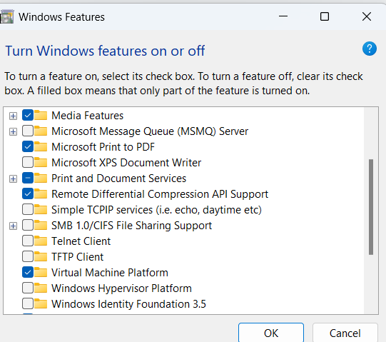
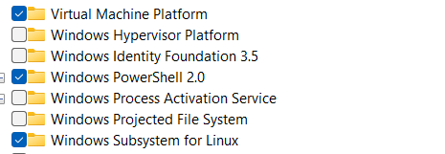
Step1:
Q1 ==> Set up Ubuntu
Enable WSL
Enable Virtual Machine Platform
windows subsystem for linux

Slide 4
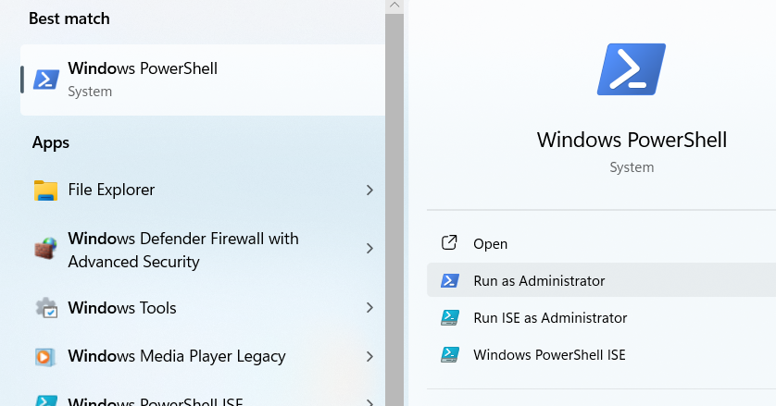
Open Windows PowerShell
click Run As Administrator

Slide 5
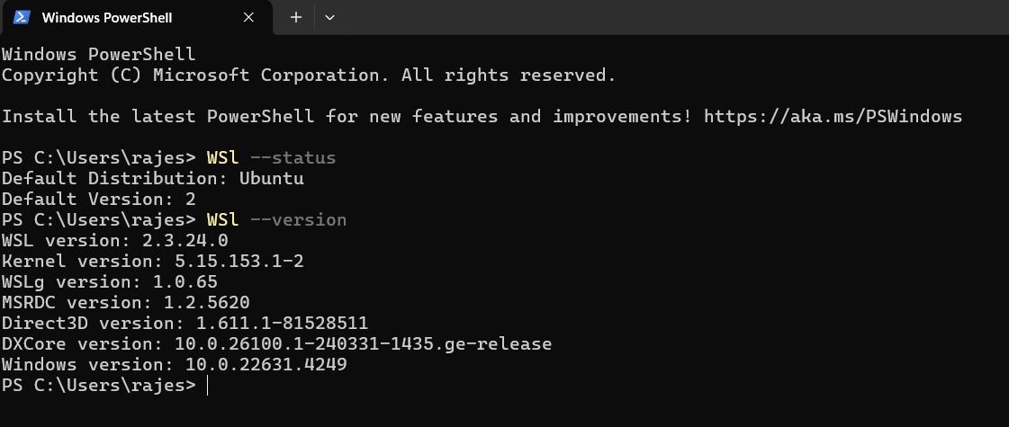
WSL Version

Slide 6
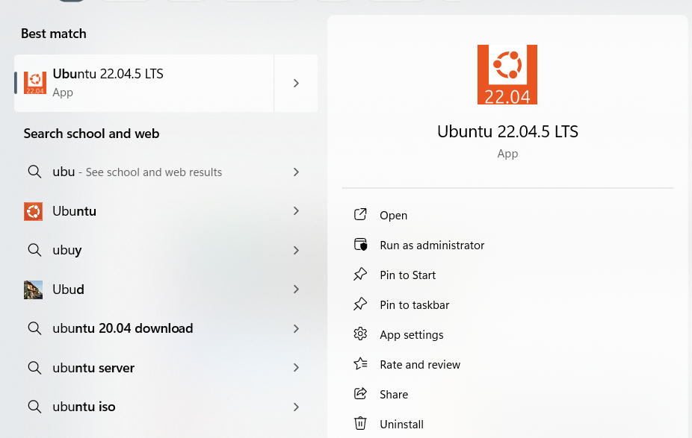
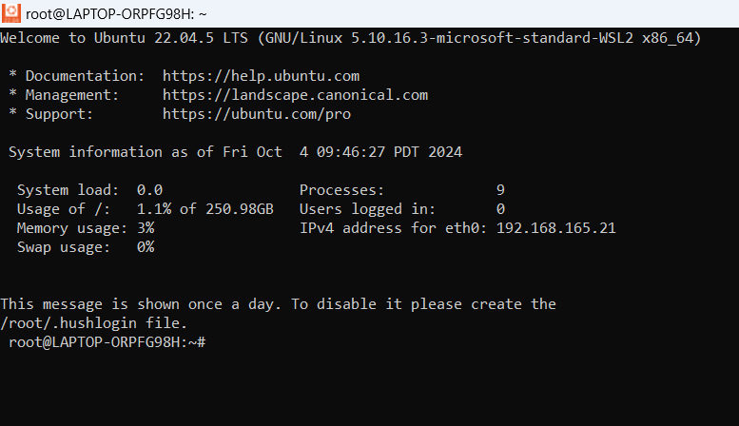
Ubuntu installed

Slide 7
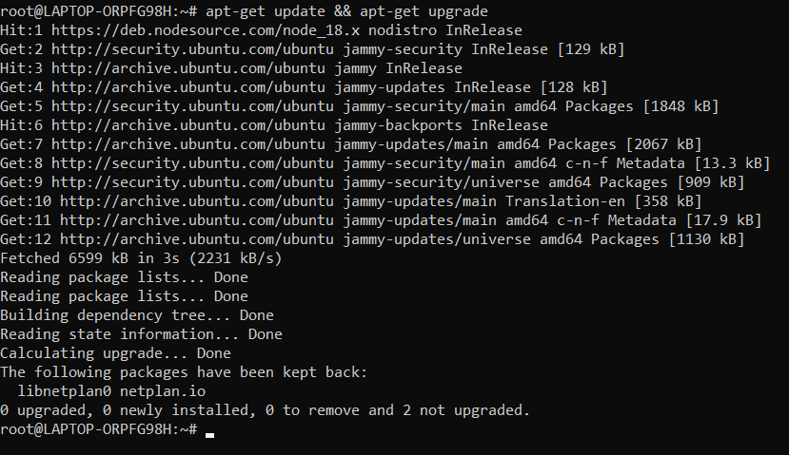
Q2 ==> Install JDK on Ubuntu
Update Ubuntu
Error: apt-get update && apt-get upgrade

Slide 8
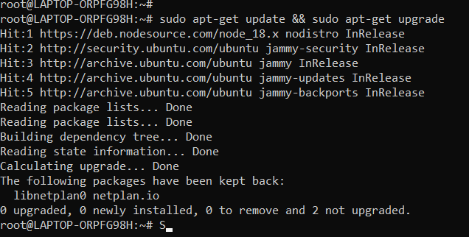
Solution: sudo apt-get update && sudo apt-get upgrade

Slide 9
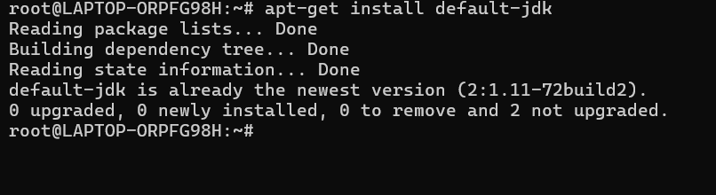
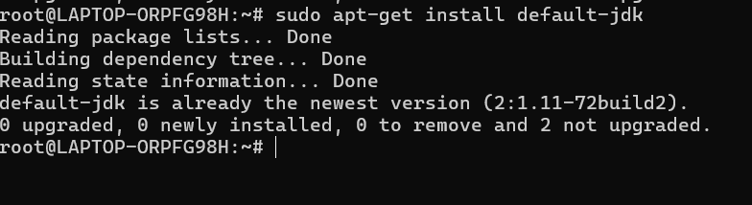
Install default JDK
Error: apt-get install default-jdkapt-get install default-jdk
Solution: sudo apt-get install default-jdk

Slide 10
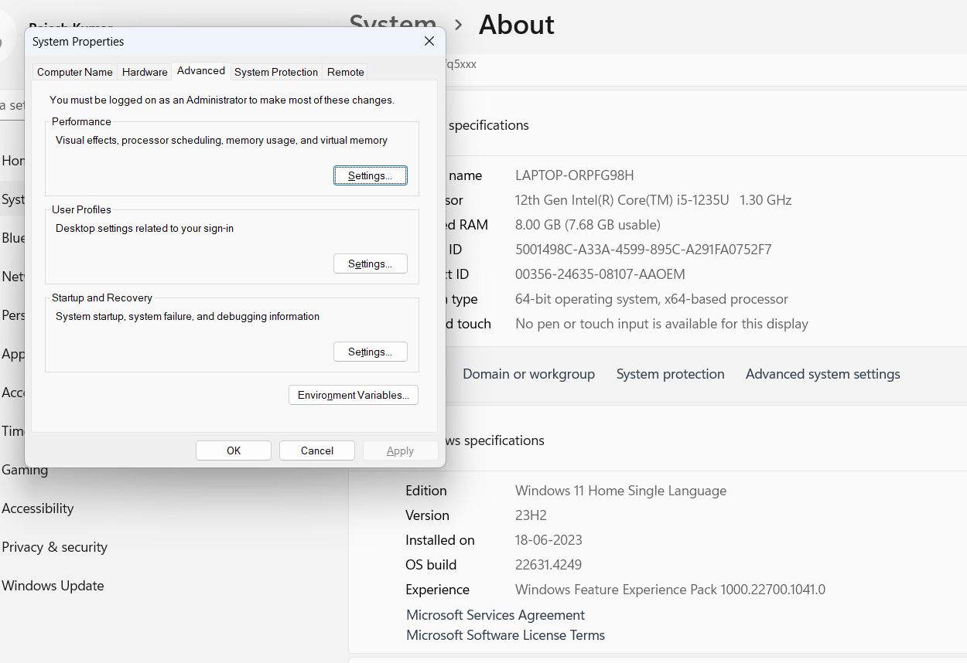
Q3 ==> Set up Java path
Go to Control Panel > System Security > System > Advanced system settings

Slide 11
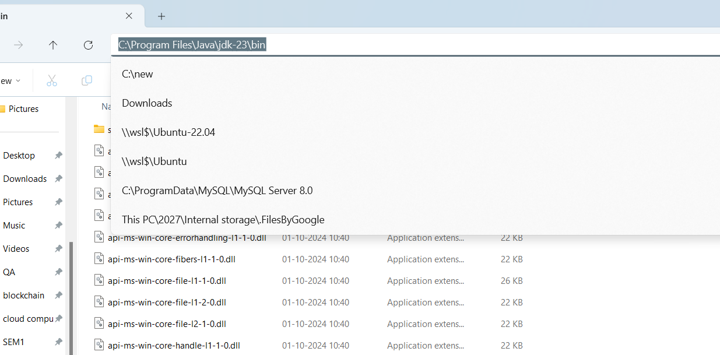
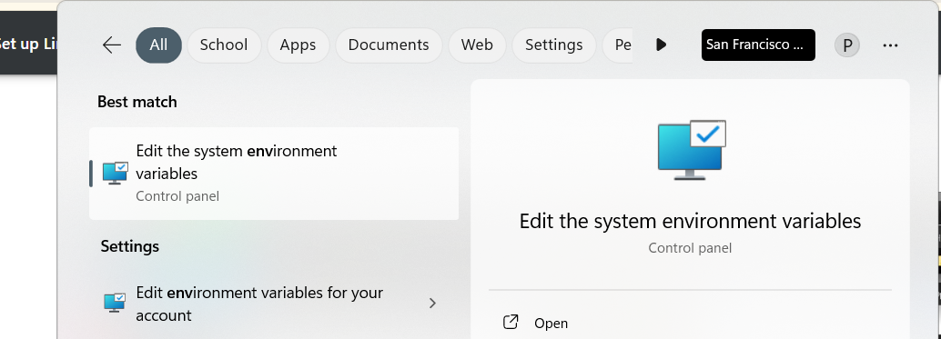
Copy Java Path

Slide 12
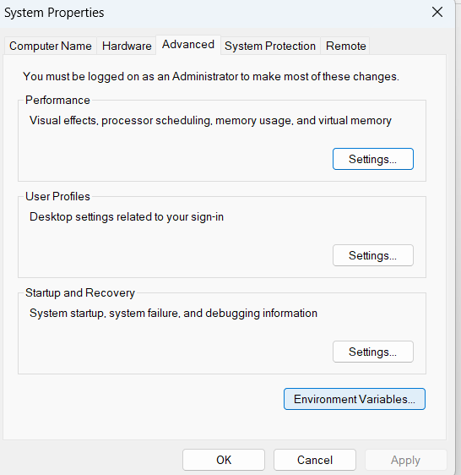
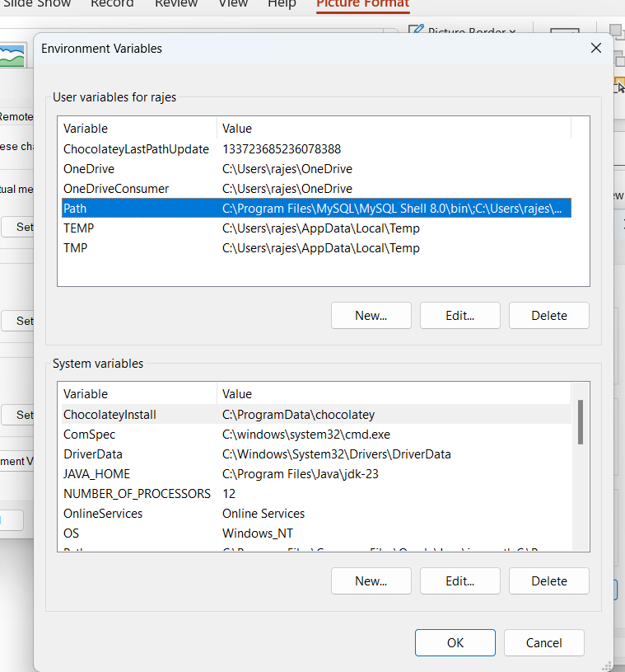

Slide 13
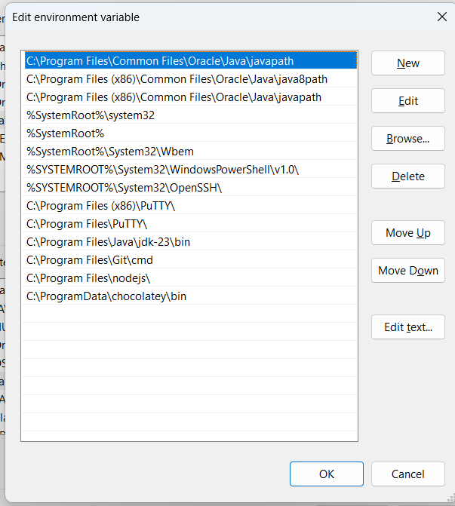
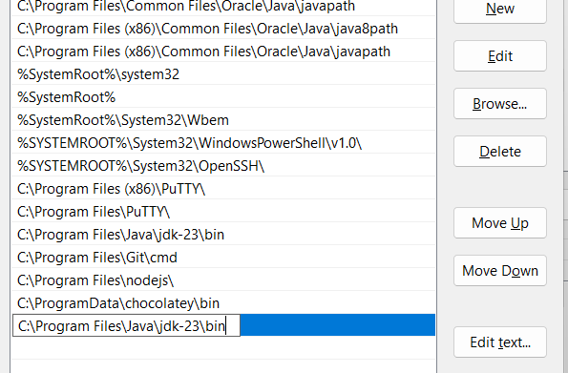
Click new
Then enter java path
Then click ok.

Slide 14
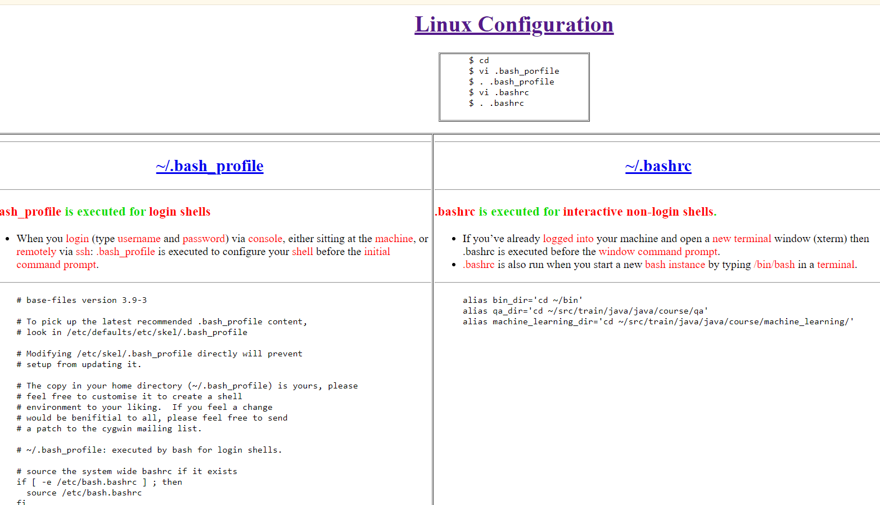
Step 4 ==> Linux Configuration
Update .profile using the given code

Slide 15
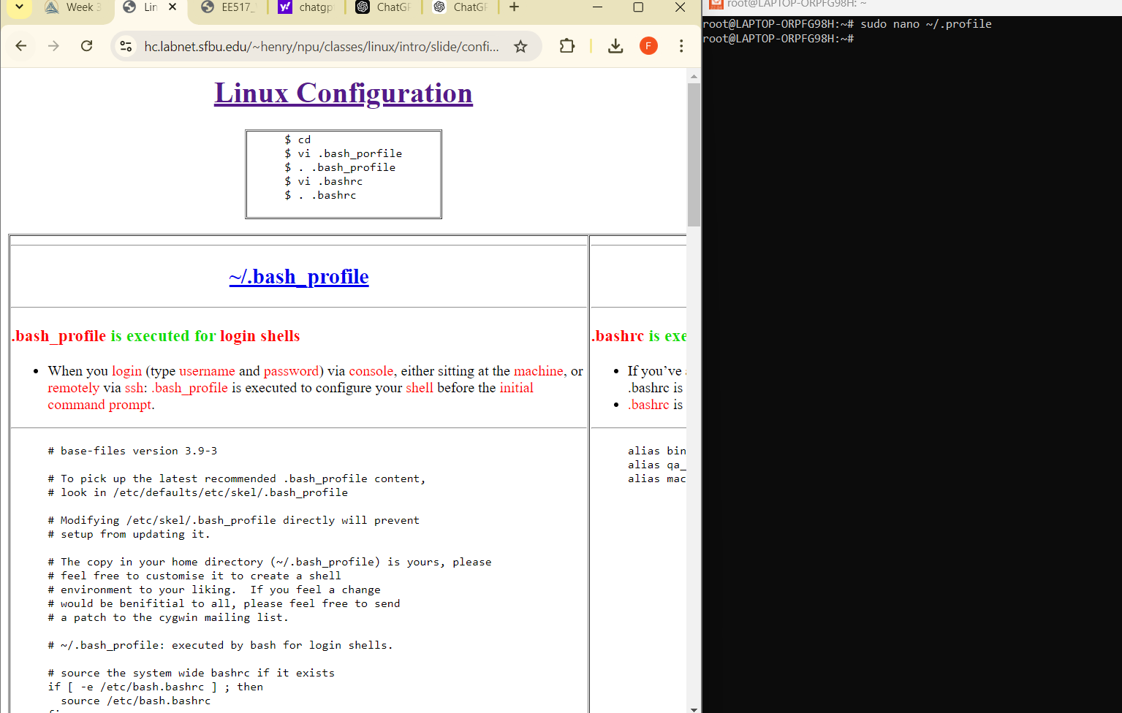

Slide 16
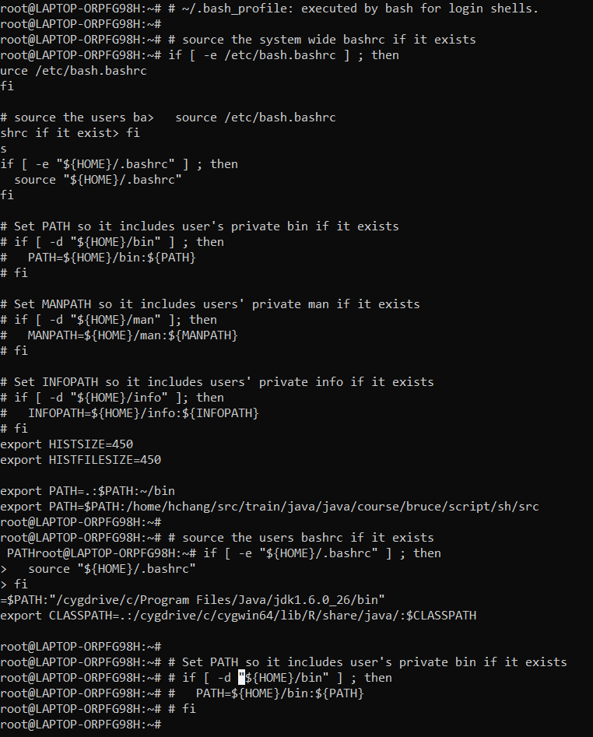

Slide 17
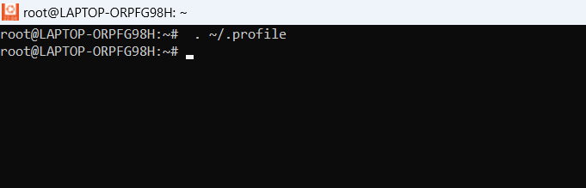
Run .profile

Slide 18
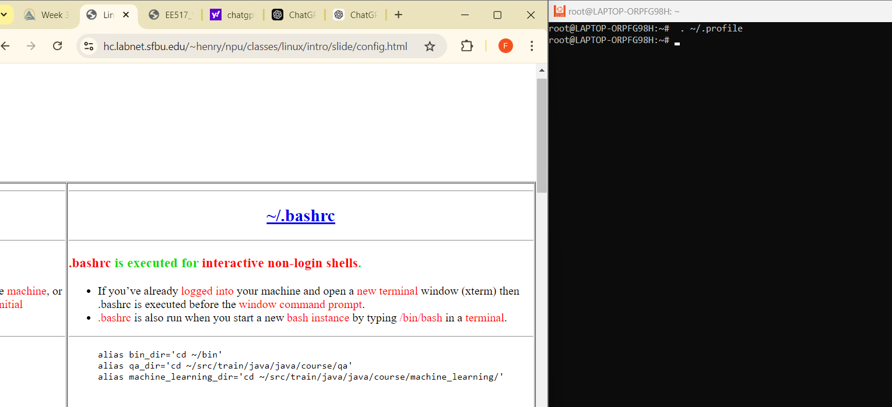
Update .bashrc using the given code

Slide 19


Slide 20
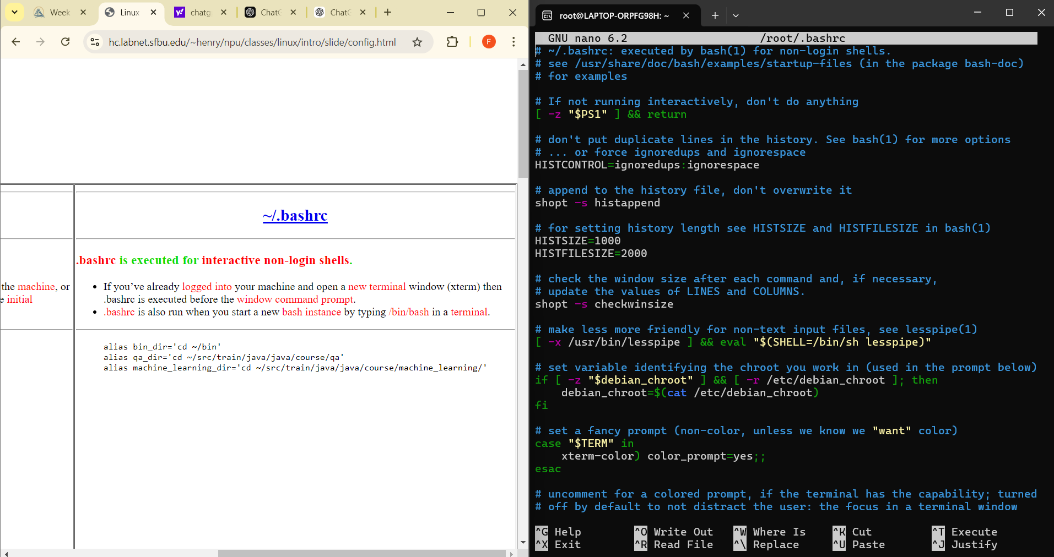

Slide 21
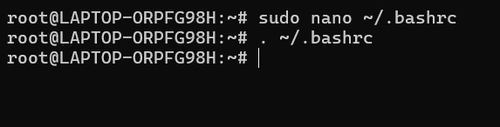
Run .bashrc

Slide 22
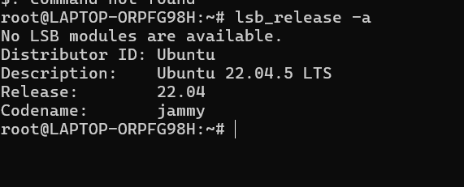
2. Ubuntu Version

Slide 23
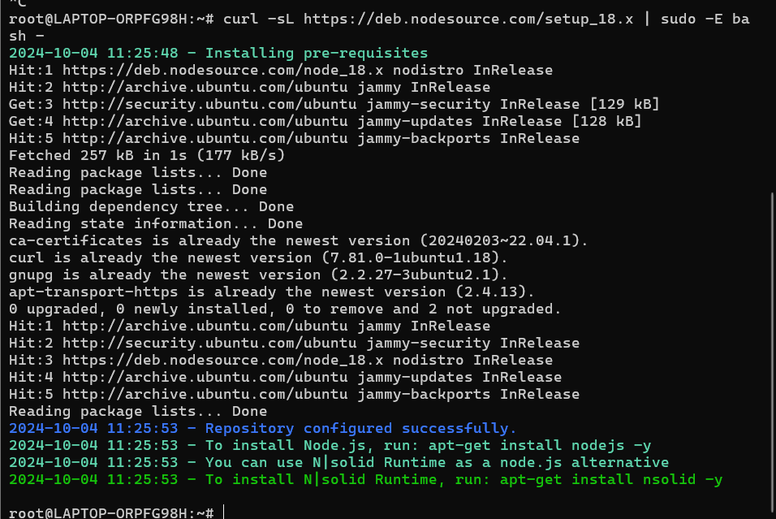
3. Enable the NodeSource repository by running the following curl
Install Node.js 18.x

Slide 24
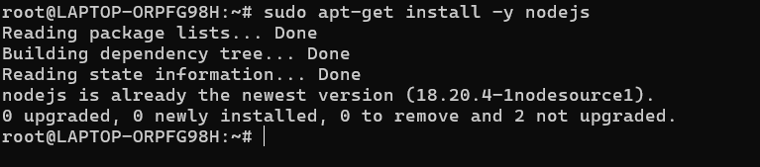
Install node.js and npm

Slide 25
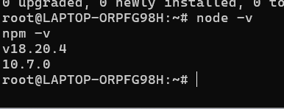
Verify that the Node.js and npm were successfully
Verify that the Node.js and npm were successfully
5. Verify that the node.js and npm were successfully

Slide 26
Step 2 :Study Time server
Node.js Time server on Ubuntu Set up environment:
Install ubuntu
2. Check your ubuntu version with lsb_release -a

Slide 27
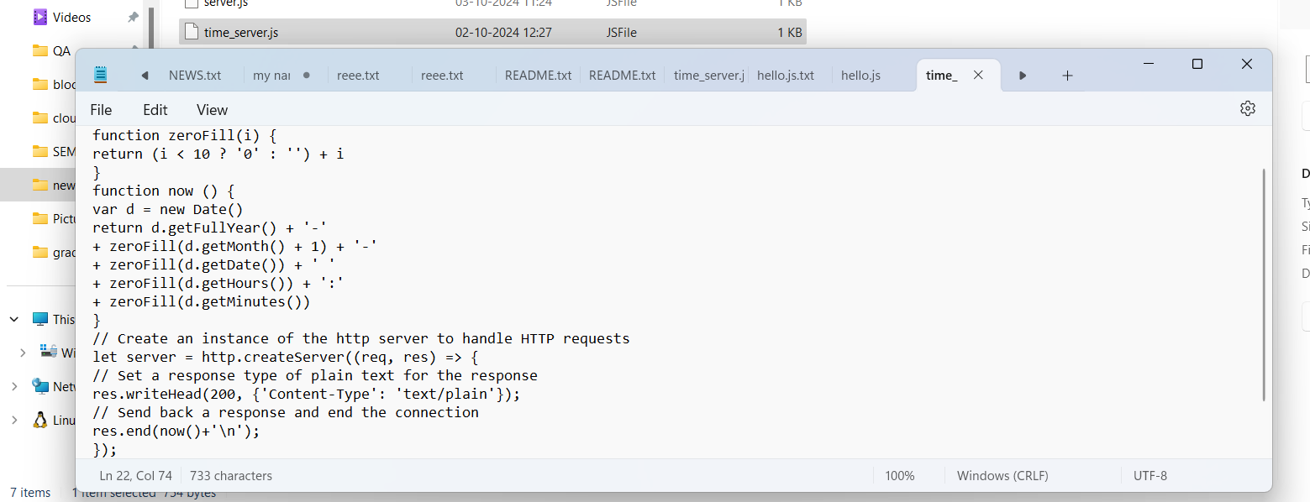
Start your node time server
1. create a file named time_server.js with the following contents

Slide 28
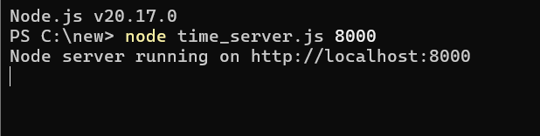
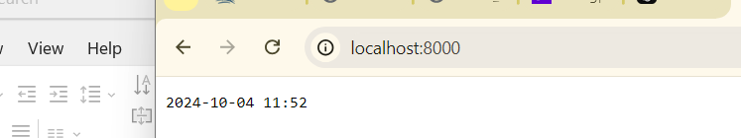
Open your ubuntu terminal
and enter node time_server.js 8000
open your browser
and go to http://localhost:8000, you should see a page with the current time like this

Slide 29
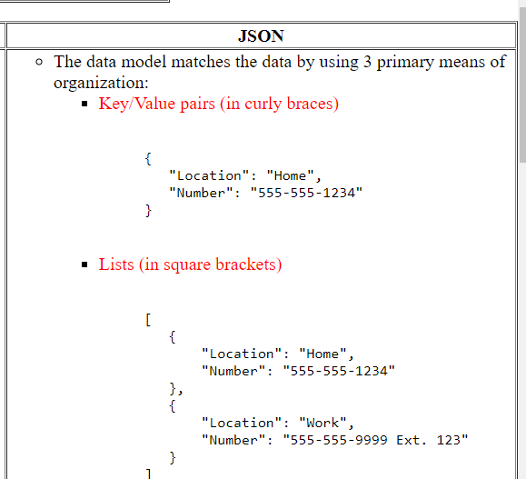
Step 3: Study Json

Slide 30
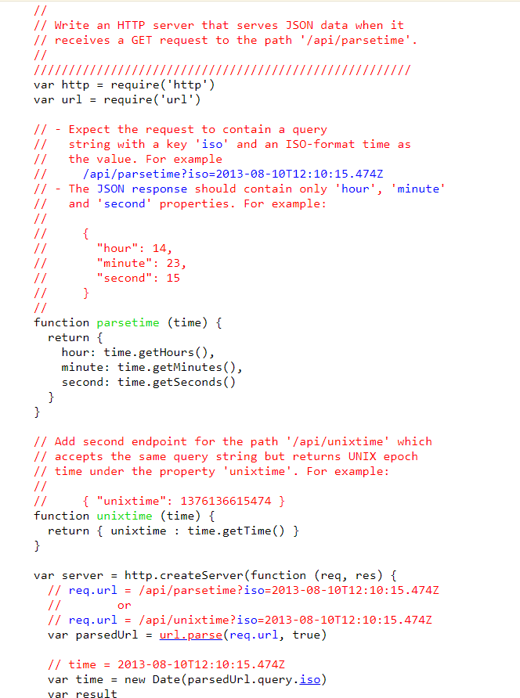
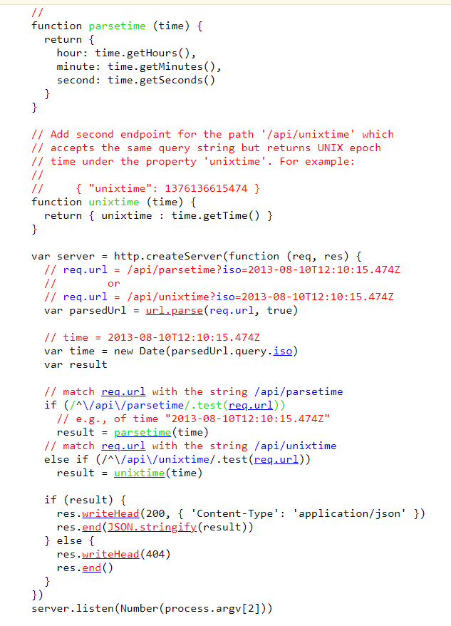
Step 4: Study HTTP Json Server

Slide 31
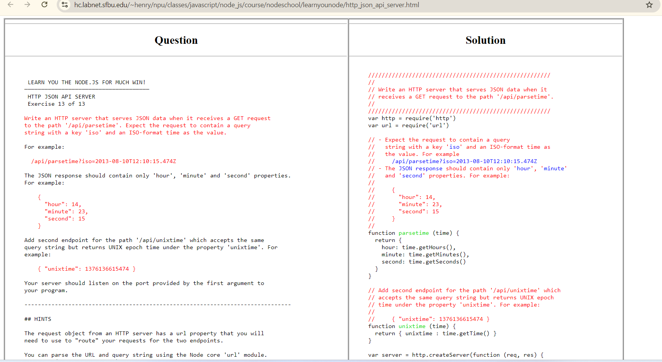
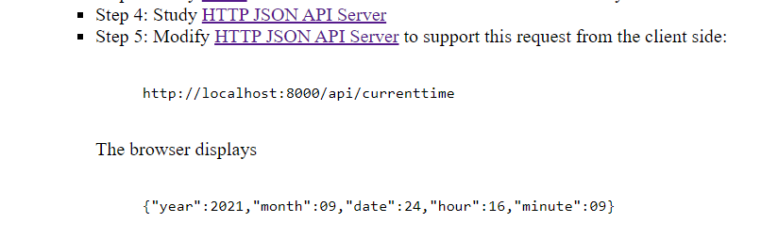
Step 5: Modify HTTP Json API Server

Slide 32
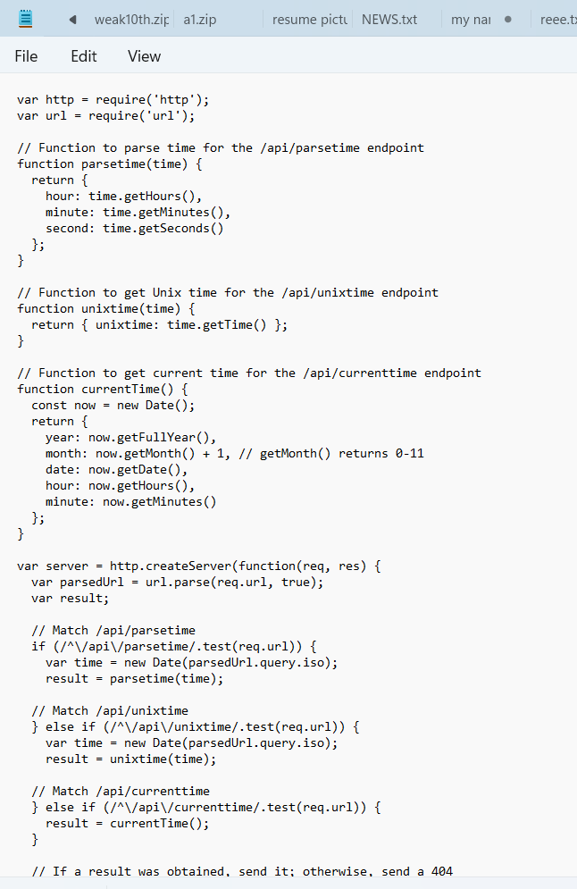
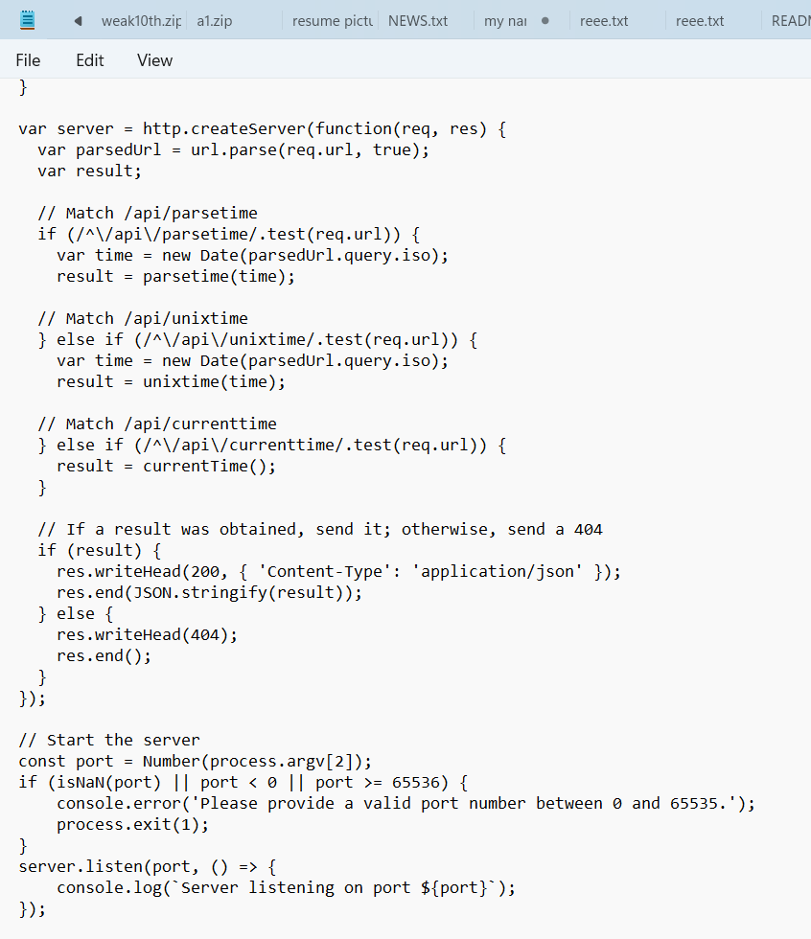
1. create a file named modify.js with the following contents

Slide 33
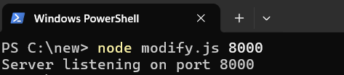
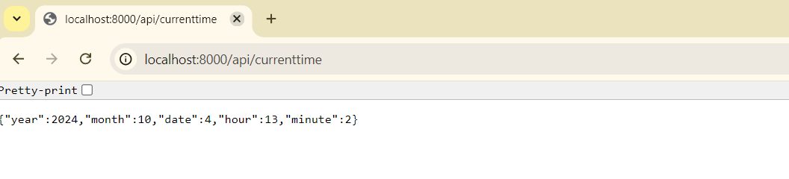
Open your ubuntu terminal
and enter node modify.js 8000
open your browser
and go to http://localhost:8000/api/currenttime,
{“year”:2024, “month”:10, “minute”:2 ,”date”:4 , “hour”:13, “minute”:2}

Slide 34


